Slide 1
Bringing you up to Speed….
Introduction to the International Dysphagia Diet Standardization Initiative (IDDSI)
Update of Diet Names and Descriptions Thickening Fluids and Measuring Flow
RD/SLP Collaboration
Deer Lodge Centre
January 2019
Notes:
KS intro.
…and maybe some other important information….

Slide 2
Today’s Objectives
Introduce IDDSI
Discuss “phase 1” implementation of liquids
Flow Test videos and demonstration
Thickening Liquids Video
Flow Test and Thickening Liquids exercise
Discuss and plan next steps – implementation and education
Nutrition and Hydration in the Elderly

Slide 3
Notes:
In 2015/2016 a committee of SLP’s and RD’s gathered together to review the WRHA Diet texture and liquid consistency section of the diet compendium. This group was given the title, the Feeding and Swallowing Expert Review Group. The last time this section of the Diet Compendium was reviewed was 2008...At the same time that the expert review group was being formed, the news of the International Dysphagia Diet Standardization Initiative was announced. This was a group of renowned international experts in the field of Dysphagia who had put together a “Framework” for diet texture and consistencies that was:
Culturally sensitive
Measurable
And applicable to all individuals, of all ages in all care settings…So, I may be getting ahead of myself….but consider….when you have a patient who is on a pureed diet in Charleswood Care Facility and their family decides to move them to Regina, they will be receiving food with the exact same properties, of the exact same name…..
IDDSI Framework was reviewed by the Expert Review Group and a decision made to move towards adopting it.
Most of the slides in this presentation today are used with permission from IDDSI and the complete presentations can be found on the IDDSI website. Some information has been omitted and other information added based on the framework that WRHA plans to implement.

Slide 4
Notes:
As you can see from the above slide, this initiative encompasses, not only you and I, but big business all over the world and healthcare organizations.

Slide 5
Notes:
In 2012 a group of professionals from around the globe came together to discuss the idea of developing international dysphagia diet standards that would meet the needs of all individuals with dysphagia. They are speech-language pathologists, dietitians, nurses, occupational therapists, physiotherapists, doctors, mechanical engineers, food technologists, and scientists. IDDSI was officially formed in 2013. Above is the current IDDSI board of directors. All board members are volunteers and all are committed to improving the safety of people with dysphagia.
From all over the world and diverse professions…

Slide 6
Notes:
Consider the following slide…(READ)….The over-riding goal of IDDSI is around patient safety. As this slide sadly shows there are choking incidents around the world from people across the age span – on this slide alone people have choked and died on food from as young as 9 months to 95 years of age.

Slide 7
Notes:
MP
IDDSI goal and purpose is: (read each line of the slide)
IDDSI is supported by many international professional associations including;
Canadian Society of Nutrition Management
Dietitians of Canada
Speech-Language and Audiology Canada
Canadian Association of Occupational Therapists

Slide 8
Notes:
Multiple labels and definitions cause confusion. Think about locations that you have visited and even the labels and definitions that you have used yourself to describe food textures and thickened liquids.
Think about the “middle” of our current diet continuum…(NEXT SLIDE)

Slide 9
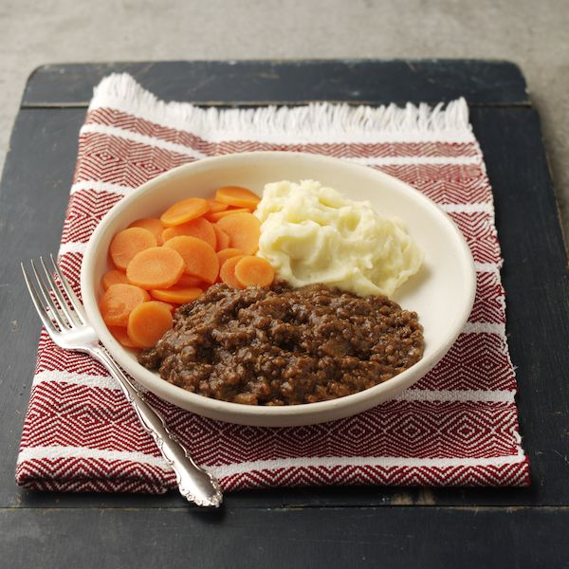
Middle of the (current) Continuum
Soft
Soft-minced
Minced
Total minced
Notes:
Frequent confusion with a few of the diets within our current diet continuum:
Soft
Soft minced
Minced
Total minced
This new framework will eliminate the issue of differences in diet names and descriptions within the WRHA. We know, there have been challenges with the names we chose.
Although we are not elaborating on textures today, you will see briefly that the names (for the future diet textures will be changing, making these middle waters not so “murky”.

Slide 10
Notes:
Often because labels for dysphagia diets have varied so greatly, an individual who is transferred from an acute care hospital to a long term care home (which may be across the street or a block or two away) needs to be re-assessed because the dysphagia diet terms are different in the 2 facilities.

Slide 11
Notes:
One commercial product is not the same as another commercial product. IDDSI has examined many samples and recipes from manufacturers and the products vary significantly. This causes great confusion for carers and individuals with dysphagia.

Slide 12
Notes:
There is great research going on but unfortunately, because different terms and definitions are used, we are unable to accurately compare and draw valid conclusions from the results of the research findings. Using the same terminology and measuring systems for research can help develop a larger body of evidence.

Slide 13
Notes:
KS
So, now that we have told you the WHY we are adopting to the IDDSI Framework, let’s learn about what it actually encompasses..) NEXT SLIDE)

Slide 14
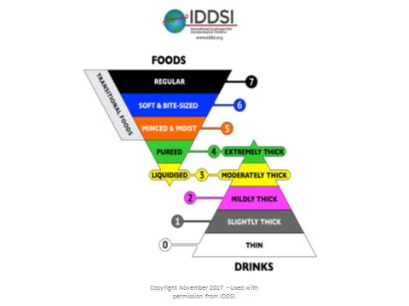
Notes:
This is the IDDSI Framwork. Each level is distinctly identified with a colour, number and a label.
More than 1 identifier will help to limit errors in prescribing, identifying, preparing and assembling dysphagia diet orders.
Our absolute PRIMARY focus today will be to focus on #3 moderately thick liquids and #2 mildly thick liquids, but before we do that, let us show you a brief comparison of what’s up and coming in the years to come….

Slide 15
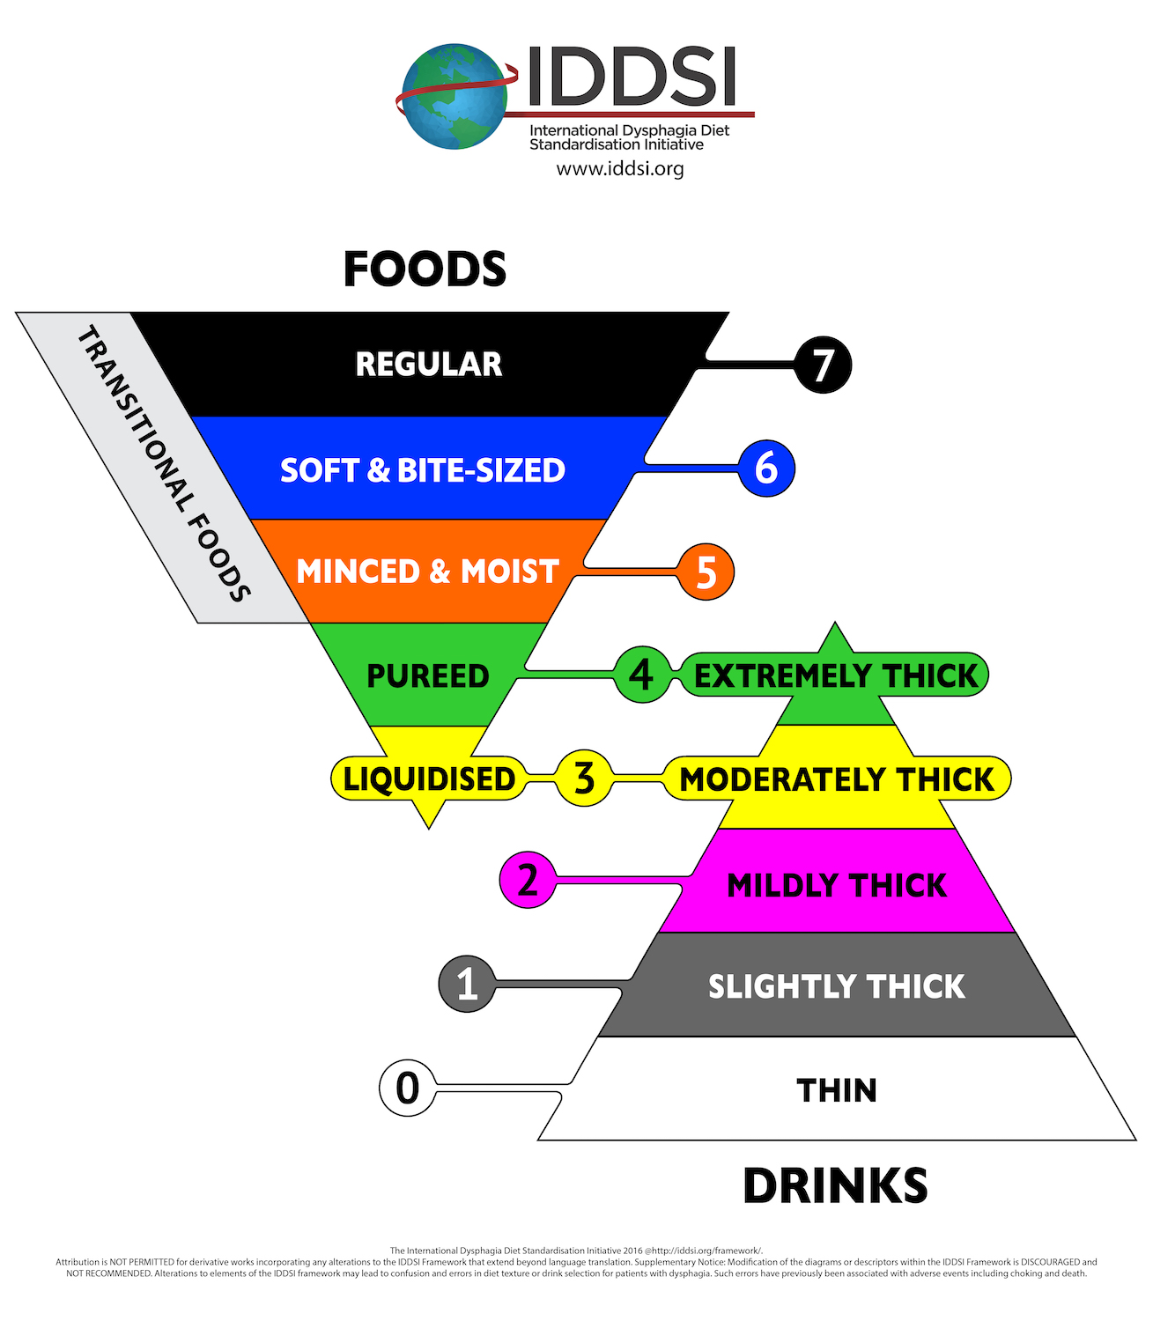
FOR FUTURE
X
=PUREED WITH NO LIQUID
X
- FOR PEDIATRICS
X
= REGULAR

Slide 16
Recommendation for Future Focus… Implementation of food textures in 2020
Food Textures and compare this to our current diets
Goal for implementation: Fall 2020
Current Terminology | New Terminology
Standard | Standard/Regular (7)
Soft/Soft Minced | Easy to Chew (subcategory 7)
Minced | To be determined
Total Minced | Minced and Moist (5)
Pureed | Pureed (4)
Blenderized | Liquidised (3)
Notes:
You will see that we still have questions and therefore a work in progress

Slide 17
Phase One: Liquids
Update Liquid Consistency Terminology and Definitions
Approximately 7% residents of PCH residents require thickened liquids
Current Terminology | New Terminology
Honey Thick | Moderately Thick (3)
Nectar Thick | Mildly Thick (2)
Notes:
Out of 100 residents that is only 7 people on thick liquids

Slide 18
Changes from Manufacturers
Manufacturers of modified foods and fluids are moving towards meeting IDDSI guidelines starting in January 2019
You will start seeing dual labelled thickened liquids in 2019
Once you finish using your site product and
suppliers have depleted their old labelled product
Within WRHA – changes to take place after April 2019
Notes:
Jean to write out some additional information (maybe)

Slide 19
IDDSI Flow Test
Materials needed:
Liquid to be tested
2 syringes*
Timer
IDDSI flow test chart
http://viscgo.com/iddsi-flow-test/
Notes:
MP
The IDDSI flow test is designed to test the ability of a liquid to flow in conditions related to swallowing a bolus. The thickness level of the liquid is defined by the amount of fluid remaining in the 10 ml syringe after 10 seconds. The IDDSI Flow test is inexpensive, accessible and easy to perform requiring only a 10 ml syringe and timer.
Note that the dimensions of the syringe are important – please ensure that the length from the zero line to the 10 mL line on the syringe measures 61.5mm. Two specific syringes have been recommended by IDDSI : 10ml BD™ Slip Tip Syringe or BD Luer-Lok Tip Syringe
The amount of liquid remaining in the syringe is compared to this chart to determine the IDDSI level
In 10 seconds, 10 ml of thin liquids will completely pass through the syringe leaving nothing left.
In 10 seconds, 4-8 ml of mildly thick liquids will remain in the syringe
In 10 seconds, 8-10 ml of moderately thick liquids will remain in the syringe
The link provides instructions, results and video – watch video. Questions?
*** The links work when in slideshow mode

Slide 20
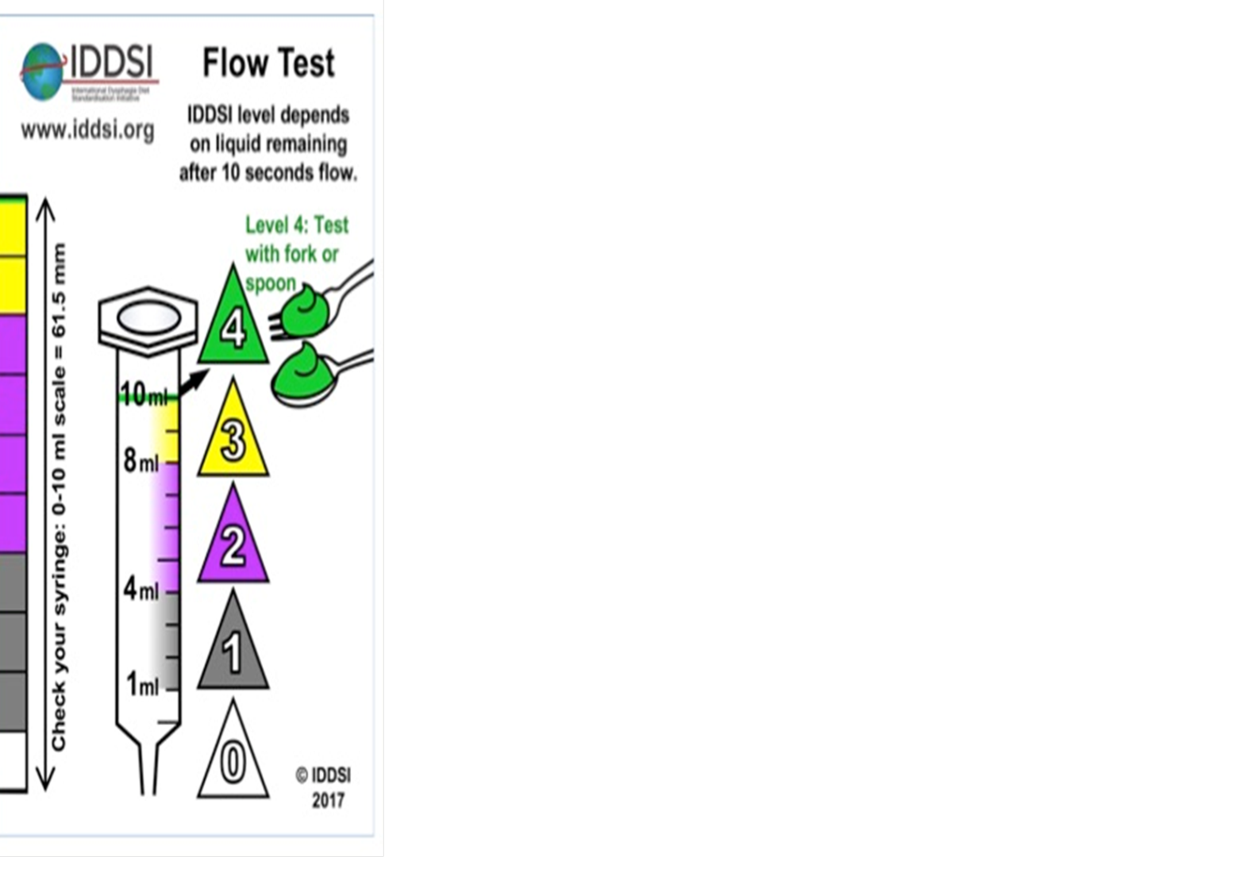
Flow Test Level 2 Mildly Thick (Nectar Thick Fluids)
https://www.youtube.com/watch?v=XBqi_i0LLHw
Notes:
Level 2 Mildly Thick is comparable to our current nectar-thick
Watch video
Refer to flow test chart – 6 ml remaining = level 2

Slide 21
Notes:
These are accessible on the website…

Slide 22
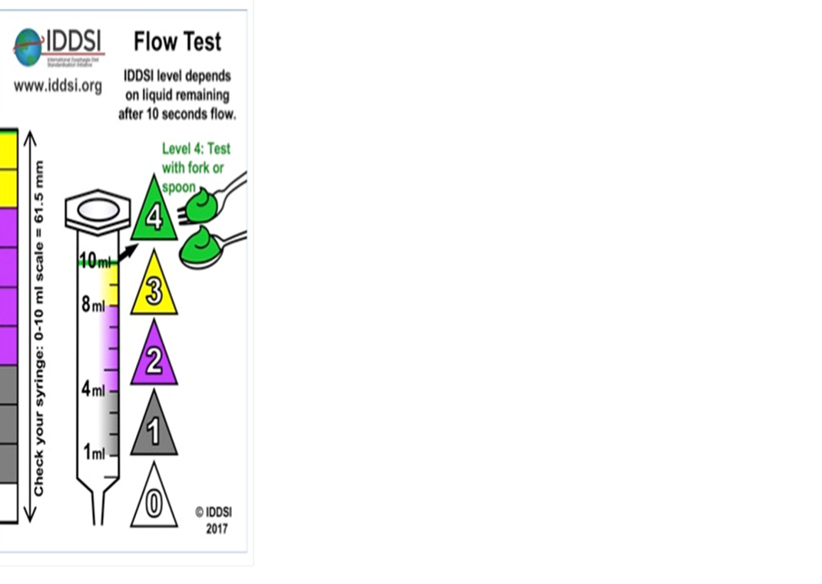
Flow Test Level 3 Moderately Thick (Honey Thick Liquids)
https://www.youtube.com/watch?v=SiFwiGgIPHA

Slide 23
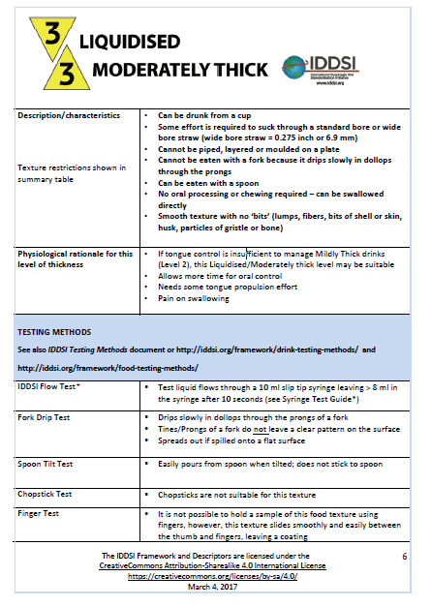
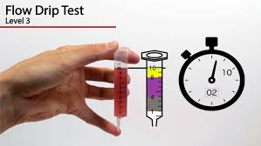

Slide 24
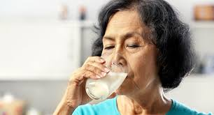
Thickening Liquids
Nestle video clip
https://www.youtube.com/watch?v=ryPPcoRjEV8
Notes:
m
We are going to give you 4 ounces of water, please thicken to mildly thick and we will flow test it in a moment

Slide 25
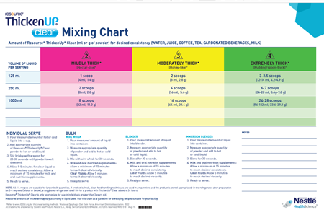
Notes:
M: You will have a copy of this chart as well. As you can see, it is a reminder of how much thickener you will need to use when thickening your product. You will in fact do this in a few seconds.
Note: The new labels and colors and numbers.

Slide 26
Notes:
JH
Audit sheet – have copies available
Standardized recipes are very important so that this testing doesn’t need to be done all the time
Spot checks/quality checks
Record the data

Slide 27
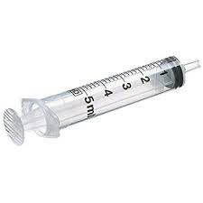
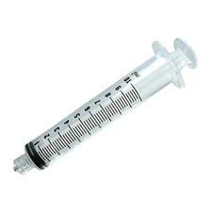
Mixing Tips & Tricks
Use the correct syringe - 10ml BD™ Slip Tip Syringe or BD Luer-Lok Tip Syringe
Load one syringe with another syringe
-ensure you have enough sample
-loading the sample – angle the syringe
-avoid bubbles
Practice with various liquid types you’re having to thicken
Notes:
JH Do not use wet syringes as water residue may cause the liquid to flow more slowly and skew the results

Slide 28
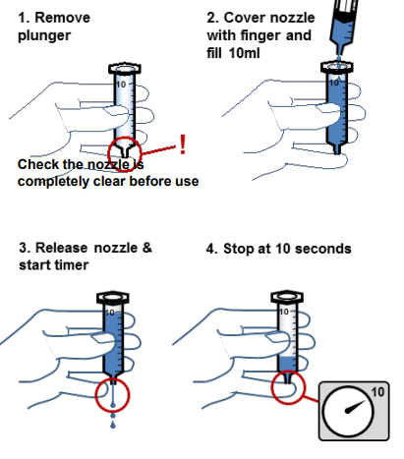
IDDSI Flow Test Demonstration
Notes:
JH
Refer to handout
Do flow tests

Slide 29
Practice flow testing
Notes:
JH Hand out syringes, liquids, audit sheets
So you watched the videos and now it is time to practice what you have seen. We will also provide you with a few working documents to work through while practicing the flow test and thickening liquids.
They practice
Discuss how the testing went. Questions? Concerns?
Soup: Discuss soup at RDF – once the testing was complete at the RDF, they discovered that all cream soups fit mildly thick/moderately thick
Resource - Level 2 when chilled (NTF)
When not chilled - doesn’t meet guidelines for moderately or mildly thick

Slide 30
FAQ
How many times should I run a liquid?
- 3-4 times
What kind of timer should I use?
- Any sensitive touch timer (e.g., phone screen timers)
Can syringes be re-used?
- yes if they are rinsed and dried between use
How should I wash my syringes?
-Soapy warm water. 3x pump through and then 2x rinse with clean warm water.
Notes:
JH If numbers are difficult to read/have rubbed off then discard syringe and use a new one

Slide 31
Focus groups
What needs to be done at the site level now?
Notes:
K So now what we ask is that at your tables, think about what needs to be done at your facility to implement the new fluid names, the flow tests, etc… Brainstorming
Focus group
Start planning – what needs to be done at the site level
Encourage discussion
We want you to think about what needs to happen in your site for successful implementation Challenges at your site

Slide 32
Next Steps
Identify site leaders
Food production
Education

Slide 33
Production
Flow test current products to determine IDDSI level
Modify or develop recipes for liquids compliant with IDDSI levels: kitchen and unit
Dual label product availability
Update terminology:
Orientation material
Production and service tools
Policies and procedures
Point of service considerations

Slide 34
Dual Labeling: Lyons Magnus/Sysco Juice

Slide 35
Hormel Milk Old label New label

Slide 36
Industry Resources
Notes:
Blue rather than yellow spoon

Slide 37
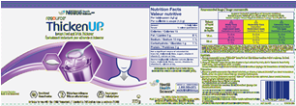
Dual Labelling – ThickenUp(Clear)

Slide 40
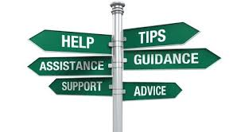
Resources
Resources – www.iddsi.org
Videos
Posters – WRHA
Notes:
Strong message – “Go forth and do ...”

Slide 42
FOR FUTURE
X
=PUREED WITH NO LIQUID
X
- FOR PEDIATRICS
X
= REGULAR

Slide 43
IDDSI
Evidence Review

Slide 44
Dysphagia
Affects approximately 8% of the world’s population
Affects 35-60% of the institutionalized elderly
Physiological changes with age like tooth loss, muscle weakness, less saliva in the mouth are common with increasing age
The modification of food texture and liquid thickness is the corner stone of dysphagia managment

Slide 45
Chewing
Poor dentition is a common reason for the use of texture modified foods and liquids
Approx. 44% of older adults have significant dental problems which affect eating
Inefficient chewing increases the risk for chocking
People who wear dentures may taste foods differently and may have impacted sensation when it comes to the force of chewing
Studies have reported that 80% of denture wearers have chewing difficulties and 40% reported swallowing difficulties

Slide 46
Hydration
Thin liquids pose an increased risk of aspiration for people with dysphagia
Thickened fluids move slower and allow more time for the airway to close to allow for a safer swallow
The use of thickened liquids has been linked to dehydration and urinary tract infections.
Recommending thickened liquids may limit the variety of liquids offered and those provided may not be well-liked, resulting in reduced intake

Slide 47
Additional Recommendations
Appropriate fluid consistencies may be provided by ready to use commercially thickened products which are advantageous as they provide a consistent product.
Where thickened liquids are prepared on-site, care should be taken to facilitate the most appropriate thickness level. This can be achieved by following IDDSI guidelines.
Hydration is important. Consider additional ways to increase fluid intake, for example, fluids between meal programs or other sources of fluids.

Slide 48
Taste Test – Thick Milk
For your consideration:
Pour 125 ml of thickened milk for yourself
Now taste it. What do you taste? Do you like it? Do you even like milk?
Now finish the portion that you provided for yourself. Could you do it? How long did it take to consume?
Remember this when considering time and patient / resident preferences at meal and snack time

Slide 49
Acceptance of Modified Foods and Liquids
Low acceptability and resulting poor adherence with modified food and liquids can contribute to an increased risk of inadequate nutrition
Although taste is very important, appearance is also believed to affect food intake. If the food is not considered visually appealing, it may be perceived poorly. Likewise positive presentation of textured modified foods and fluids, positively improves intake in persons with dysphagia

Slide 50
Feeding Independence
Feeding dependence poses a risk for aspiration in patients with dysphagia due to factors like uncontrolled presentation of food
Environmental modifications such as reducing noise level, increasing lighting and removing “extras’ on the table may aid in feeding independence.

Slide 51
The Mealtime Experience
“Mealtime is a social experience. It is important to consider how dysphagia and or self feeding challenges impact a patient’s or resident’s enjoyment of meals. Embarrassment with the texture of food, or the need for assistance may lead to reduced oral intake and social isolation. Eating with others in a calm relaxed, supportive environment maximizes swallowing safety, consumption of food and enjoyment of meals”.

Slide 52
Notes:
Questions and once again, thank you to our wonderful sponsors!

