Slide 1
Support Services to Seniors Orientation Winnipeg Health Region
Notes:
Website: https://wrha.mb.ca/support-services-to-seniors/

Slide 2
What is Support Services to Seniors?
Support Services to Seniors promotes healthy living and assists older adults by supporting community-based services and programs. Community agencies offer these services throughout the Winnipeg Health Region.
Support Services to Seniors | Winnipeg Regional Health Authority
Notes:
https://wrha.mb.ca/support-services-to-seniors/

Slide 3
What are the goals of Support Services to Seniors?
To reduce barriers to improve and/or maintain health status,
To foster social and physical environments that support health and independence,
To promote optimal well-being through lifelong learning,
To increase health promotion, chronic disease management, social connectedness,
To prevent and/or postpone disabilities, distress, discomfort and preventable injury,
To increase the capacity of older adults to have meaningful control over their health and well-being.

Slide 4
Aging in the Right Place
93.2% mainstream housing (house, apartment, condo, etc.)
6.8% collective dwellings (retirement homes, long-term care facilities or health care related facilities)
Source: Report on Housing Needs of Seniors, 2019 Census
Notes:
Source: Report on Housing Needs of Seniors
2016 Census https://www.canada.ca/content/dam/canada/employment-social-development/corporate/seniors/forum/report-seniors-housing-needs/report-seniors-housing-needs-EN.pdf
FACTS TO CONSIDER:
Older adults 65 years of age and over are the fastest growing age group in Canada. In 2016, there were 5,935,635 seniors, who represented 16.9% of the total population in
Canada and this percentage is expected to increase to 24% by 2036.
The 2016 Census reported that 93.2% of seniors lived in private dwellings (house,
apartment or moveable dwelling) while 6.8% lived in collective dwellings, such as residences for senior citizens, long-term care (LTC) facilities or health care related
facilities.
Approximately 25% of Canadian households are led by people over the age of 65 years, 75% of these households are owned and 25% rent accommodation. The largest
proportion of these senior-led households are couples without children; the second largest group is single women.
In 2016, 2.2 million Canadians lived in multigenerational housing, 349,350 of whom were aged 65 and over
Excellent resource book for consideration
Promoting the Health of Older Adults: The Canadian Experience Edited by Irving Rootman, Peggy Edwards, Melanie Levasseur and Frances Grunberg
2021 p.110
93.2% of older adults in Canada lived in mainstream housing (house, apartment, moveable dwelling),
6.8% lived in collective dwellings (retirement homes, long term care facilities or health care related facilities.
Mainstream Housing – housing model where older adults stay in their usual homes, apartments, or condos, which are not specifically intended for seniors, or downsize to ground-oriented options (one-level floor plan) in the mainstream full-price housing market

Slide 7
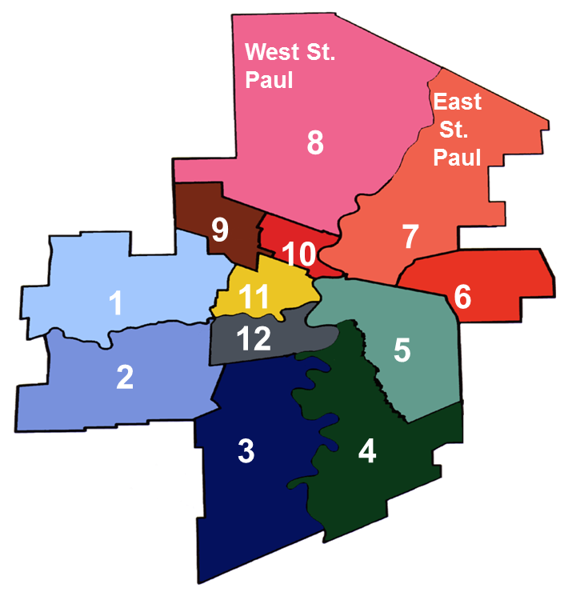
Senior Resource Finder
Senior Resource Coordinators are information and referral hub system navigators
Link and refer 55+, service providers and family members to available community supports, programs and services
E.R.I.K.® (Emergency Response Information Kit)
Escorted transportation and other transportation options
Yard and home maintenance referral program
Networking and community outreach to identify & create
partnerships for innovative services and programs
Congregate meal program options
Educational materials and community presentations
Seniors Resource Finders | Winnipeg Regional Health Authority
Notes:
https://wrha.mb.ca/support-services-to-seniors/seniors-resource-finders/

Slide 8
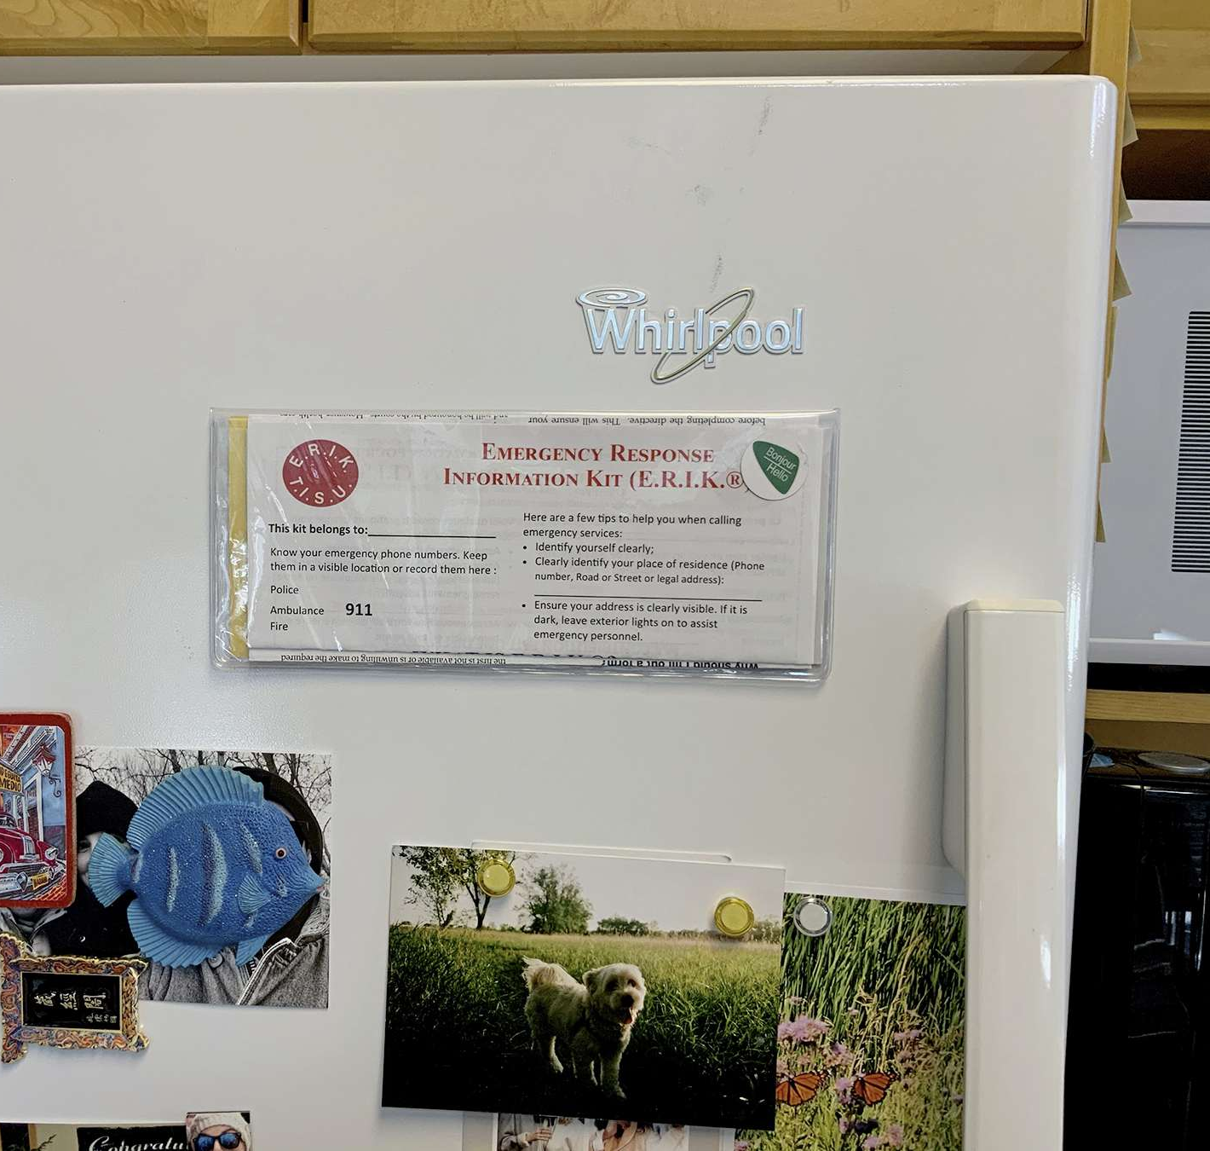
Emergency Response Information Kits (E.R.I.K.®)
Developed by the Seniors Resource Finders (rurally Community Resource Councils)
Recognized as a Provincial program
Response to concerns about the availability of information in emergencies
Endorsed by all area emergency groups
Provides the necessary information for emergency personnel to respond quickly to an individual’s situation
Contact your local senior resource coordinator for kits and presentations
Notes:
Replenishing of kits is approx. $2.00 each for cost recovery of materials
Coordinators use an equity lens and will not deny an individual a kit.
E.R.I.K. bulk supply free to ER social work department, Cancer Care and Cardiac transplant.

Slide 9
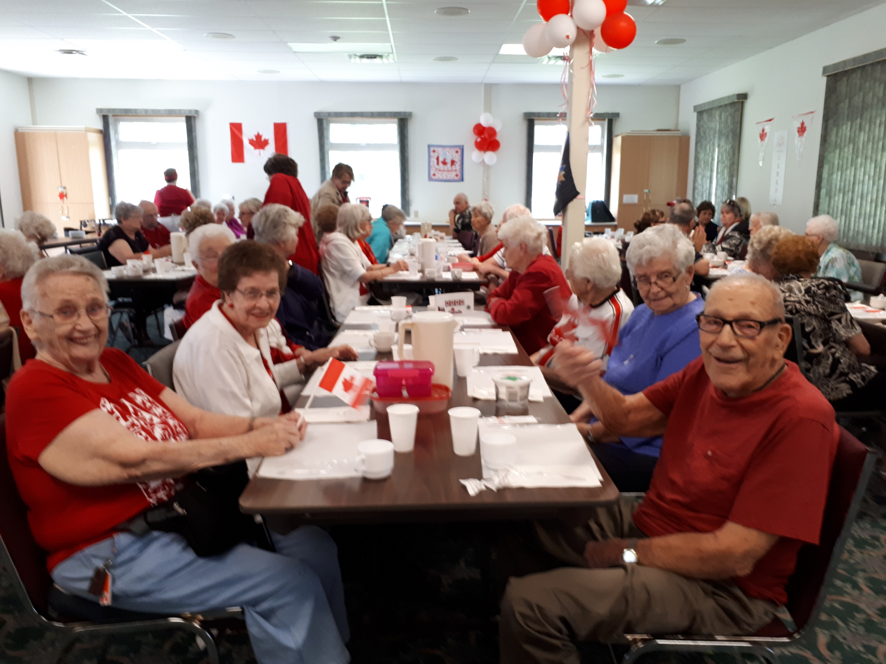
Congregate Meal Programs
Affordable and nutritious meals in a group setting
Targets those who are unable to prepare meals on a regular basis
Risk of isolation
Reasonably priced meals
Volunteer and leadership opportunities
Congregate Meal Programs | Winnipeg Regional Health Authority
Notes:
https://wrha.mb.ca/support-services-to-seniors/congregate-meal-programs/

Slide 10
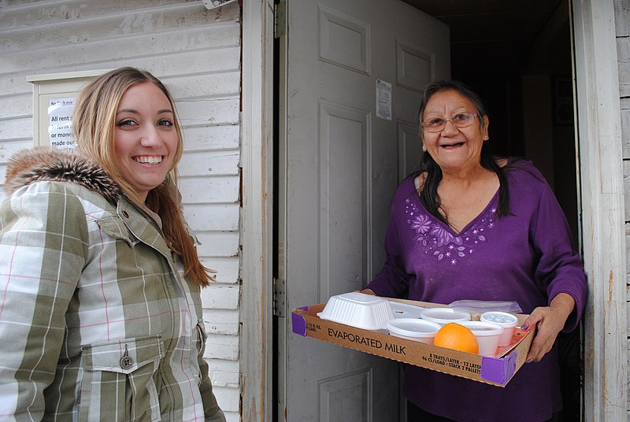
Affordable, nutritious meals delivered to individual’s home
Services can be accessed at any age
Delivered by volunteers
Available to people regardless of age who are unable to prepare or otherwise obtain meals on their own
Hot meals, kosher meals, larger portions, supper bags and frozen meals
Meals on Wheels Winnipeg Home Page - Meals on Wheels Winnipeg
Notes:
https://www.mealswinnipeg.com/

Slide 11
Tenant Resource Services
Targeted to adults living in independent housing apartment buildings
Coordinators develop and coordinate a service plan for tenants
Connect tenants to services and support independent living in the community such as:
Information and referral
Advocacy
Health clinics
Grocery shopping options
Friendly visits
House cleaning referrals
Translation
Filling out forms, etc.
Tenant Resource Programs | Winnipeg Regional Health Authority
Notes:
https://wrha.mb.ca/support-services-to-seniors/tenant-resource-programs/

Slide 12
Supports to Seniors in Group Living
Housing with enhanced services that support health promotion and independence with a goal of aging in place
Support with instrumental activities of daily living (IADL), and not 24 hour support and supervision
Can include:
information and referrals
assistance with filling out forms,
setting appointments,
arranging transportation,
social/education/support groups, etc.
Supports to Seniors in Group Living | Winnipeg Regional Health Authority
Notes:
1,132 suites
To assist in providing an environment that meets the needs of older adults and reduces the likelihood of institutionalization, urgent care, emergency admissions, etc.

Slide 13
Senior Centres/55+/Active Living Centres
Community focal points where adults 55+ come together for services, programs and activities
Promote, maintain and improve health and quality of life
Support independence
Encourage involvement in the community
Address the determinants of health
Provide resource information on living well
Senior Centres / Active Living Centres | Winnipeg Regional Health Authority
Notes:
https://wrha.mb.ca/support-services-to-seniors/senior-centres/

Slide 14
Senior Centres/55+/Active Living Centres
Activities can include:
Physical fitness & exercise programs
Leadership development
Health promotion, social, recreational, cultural and educational programs
Volunteer opportunities
Advocacy
Information and referrals
Notes:
https://wrha.mb.ca/support-services-to-seniors/senior-centres/

Slide 15
Manitoba Association of Senior Communities
The Association is a provincial focal point to facilitate communication, networking and planning among senior centres and raise their profiles
The Association specializes in support to member groups, Age Friendly Manitoba, and Social Prescribing
Home page - MASC
Notes:
https://www.manitobaseniorcentres.com/

Slide 16
Canadian National Institute for the Blind
Delivers innovative programs and advocacy that empower people impacted by blindness to live their dreams and tear down barriers to inclusion
Services offered include:
Peer Support.
Store and library services.
Leisure groups and activities.
Offer specialized services and training
Programs and Services | CNIB
Notes:
https://www.cnib.ca/en?region=mb

Slide 17
Alzheimer Society of Manitoba
Provides community awareness; individual, family and professional education; support programs and research funding
First Link®
Formal referral by health professionals allows for proactive contact to help the family better cope
Link individuals and families affected by dementia with services and support as soon as possible after diagnosis
Information, support groups, education sessions and referrals to other health resources as needed
Families can also contact the Alzheimer Society directly for assistance
Alzheimer Society of Manitoba - Dementia Care & Brain Health
Notes:
https://alzheimer.mb.ca/

Slide 18
A&O: Support Services for Older Adults
Core programs and services are classified under the agency’s three foundational pillars: Safety & Security, Social Engagement and Counselling
Information and referrals, counselling, housing, legal services, seniors immigrant settlement services, this full house, caregiving with confidence, senior centre without walls, older victim services, safety aid, connect program, elder abuse services, safe suite, etc.
A & O: Support Services for Older Adults – Providing innovative programs and services to older adults since 1957
Notes:
https://www.aosupportservices.ca/
Information and referrals - information about a wide range of services for older adults and links or refers them to the network of programs that exist in the community.
Counseling - Some of the services available address loneliness, death of a family member, loss of health and adult-child, grandchild/aging parent relationships.
Housing – connect with a housing project coordinator and housing guide.
Legal services - on matters such as wills, powers of attorney and health care directives.
Entry Program for Older Adult Immigrants - orientation for newcomers about living in Canada; Health and aging in Canada; Canadian laws and citizenship; Housing and community information and conversation circles to practice English skills.
This Full House (hoarding) - assist older adults whose “stuff” fills their homes and limits their lives.
Caregiving with Confidence – supports caregivers of older adults through information and referrals; telephone and group support; Ring a Ride and respite services
Senior Centre Without Walls - offers a unique opportunity for socially isolated older adults. Free half-hour programs are accessed through a toll-free number.
Older Victim Services - service developed in partnership with A & O and the Winnipeg Police Service. Assistance is provided to older adults who have been victims of property crime, such as a break-in to their residence, and personal crimes, such as assault or robbery.
SafetyAid – falls prevention program that gives seniors a greater sense of safety and security in their homes.
Connect Program (formerly friendly visiting) - assist socially isolated older adults living within the community in Winnipeg, connecting them to resources that will facilitate independent living.
Volunteer Opportunities - flexible volunteer opportunities available throughout a variety of programs.
Elder abuse services - Social Workers respond to the needs of individuals 55+ who are experiencing neglect, emotional, financial, sexual or physical abuse. Information and resources are provided to family and friends who may be concerned about an older adult.
Services include:
Safe Suite - Provides temporary housing for men, women and couples, 55 years or older who are in need of a safe place to stay due to abuse or neglect and whose needs cannot be effectively met by existing abuse/crisis services.
Senior’s Abuse Support Line - is available 24-7; calls are free and confidential. Counsellors are trained to provide one-on-one support to older adults experiencing abuse.
Counselling regarding the abuse and options available
Referral to appropriate community resources
Consultation and referral for family members
Support Groups
Assistance accessing crisis accommodations and legal services, including protection orders
Information and Education

Slide 19
Community Partners
211 Manitoba: Manitoba
Active Aging in Manitoba: Active Aging in Manitoba | Inspiring Active Lifestyles
Canadian Mental Health Association: Winnipeg - CMHA Manitoba and Winnipeg
Health, Seniors and Long Term Care: Province of Manitoba | Health, Seniors and Long-Term Care
Transportation Options Network for Seniors: Home – TONS

Slide 20
Support Services to Seniors
Kathy Henderson, BSW, RSW
Healthy Aging and Seniors Care Specialist
Support Services to Seniors
Health Services | Continuing Care
Winnipeg Regional Health Authority
(204) 791-2066
khenderson@wrha.mb.ca
https://wrha.mb.ca/support-services-to-seniors/
Notes:
https://wrha.mb.ca/support-services-to-seniors/

